Slide 1
Monthly Newsletter
Summer 2018
Unfortunate news about the newsletter’s summer
As you may have heard, our monthly newsletter was involved in a horrific bicycle accident which left him defying the odds of survival. He was involved in a collision with a truck while out on a nice leisurely ride to enjoy the summer days.
The truck driver was allegedly charged with distracted driving, as he was reading the Monthly Newsletter’s latest update. Luckily though, the accident occurred at the intersection of Willowdale Ave and Cummer Ave, near St. John’s Rehab.
Larry Robinson, who witnessed the accident, asked, “How’s the bike?” After assessing the scene once the ambulances arrived, he then asked, “is the frame and fork okay with no cracks, are the wheels straight, are the brakes and gears sill working properly?”
The Monthly Newsletter was transported to St. John’s Rehab and was cared for by a great team. With the help of much therapy, he began to speak and finally walk again with his great motto of, “Don’t limit your challenges, challenge your limits”.
Photos of the newsletter’s accident and rehabilitation are below.

Slide 2
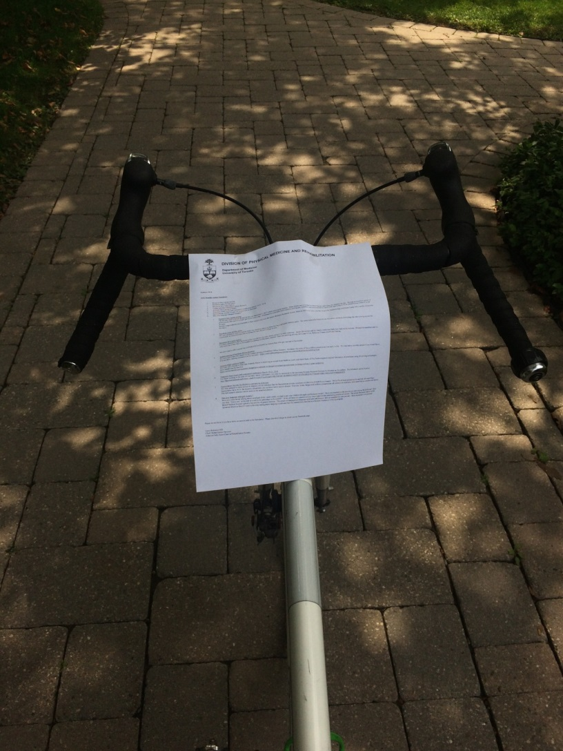
I want to ride my bicycle, bicycle, bicycle….
The start of my summer ride

Slide 3
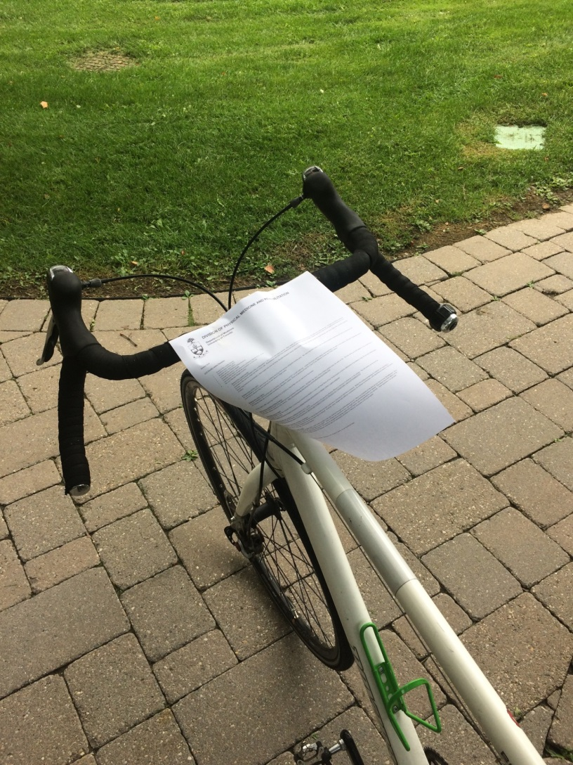
I want to ride my bicycle
Starting to lose my grip on the handlebars

Slide 4
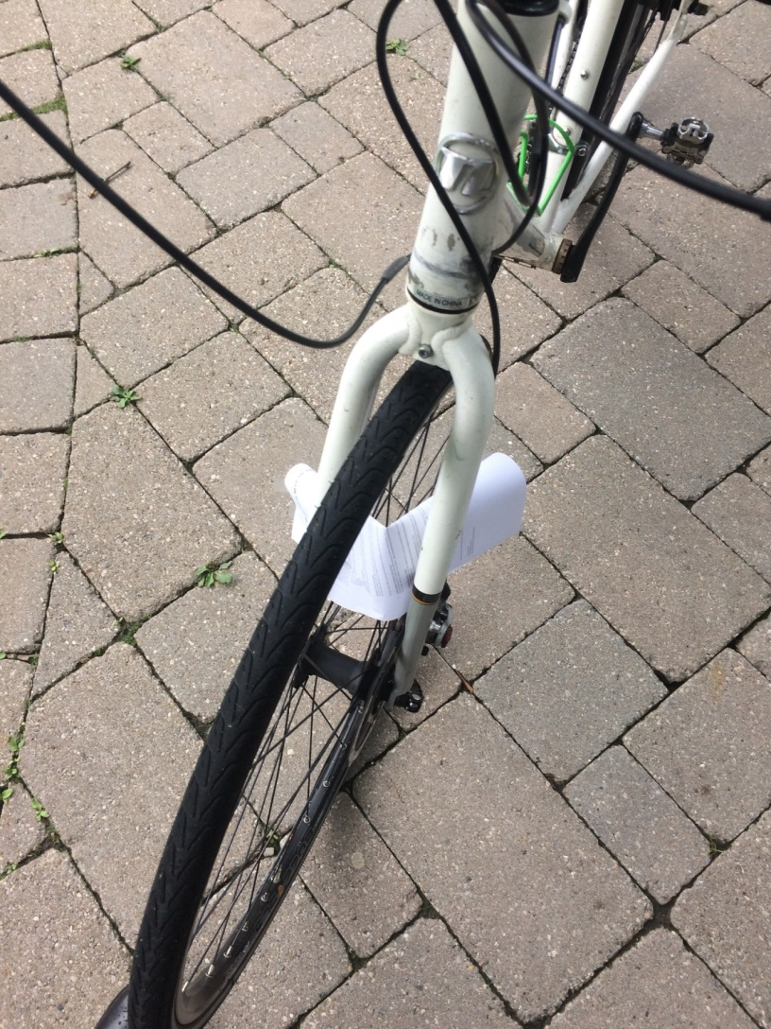
Oh No! Ouch, I spoke too soon!

Slide 5
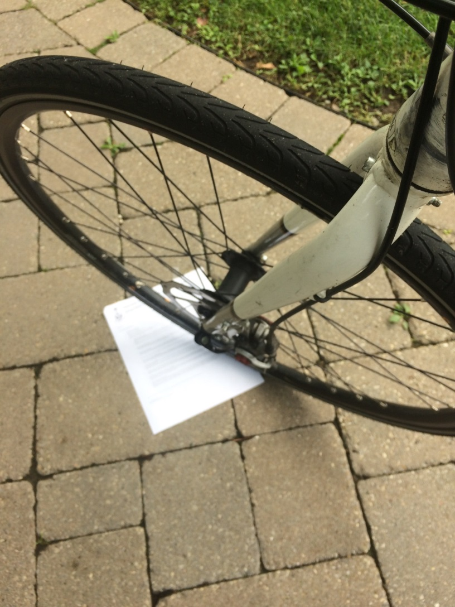
Saw a truck coming and tried to jump out of the way

Slide 6
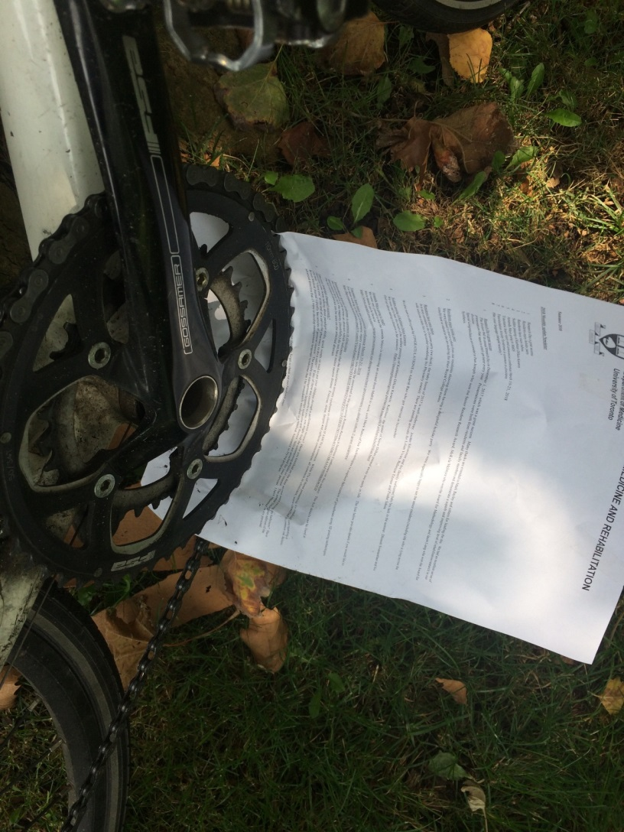
It was a chain reaction

Slide 7
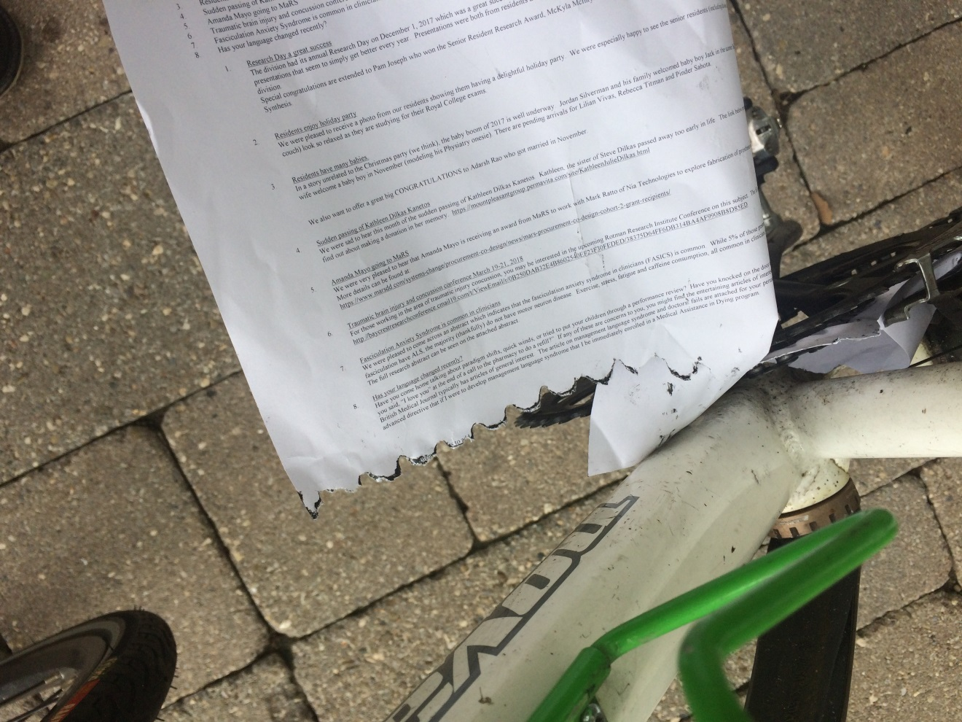
Partial tear of the lower extremity

Slide 8
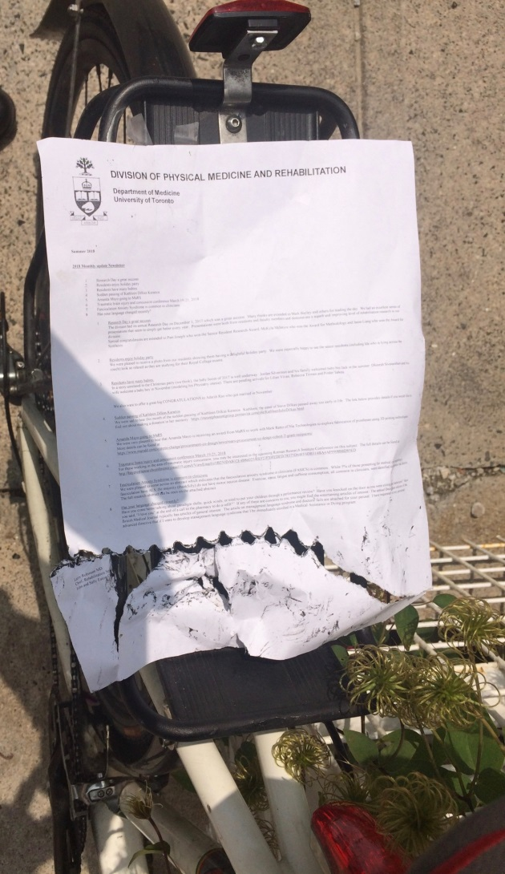
On the way to the hospital

Slide 9
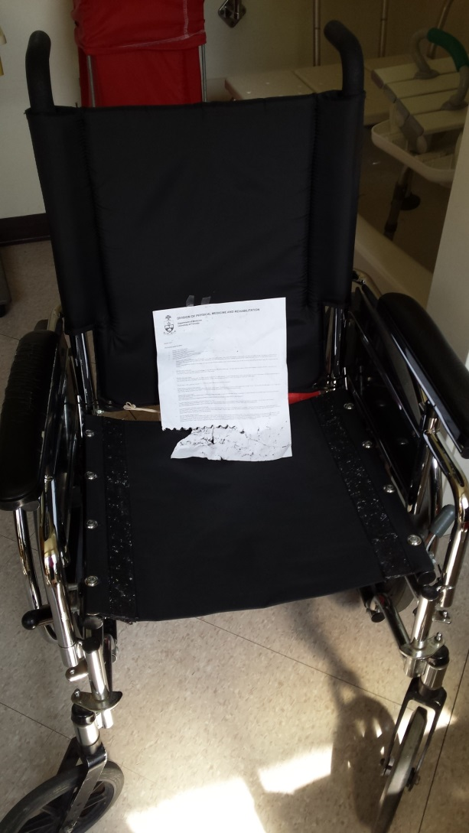
Transported by Wheelchair

Slide 10
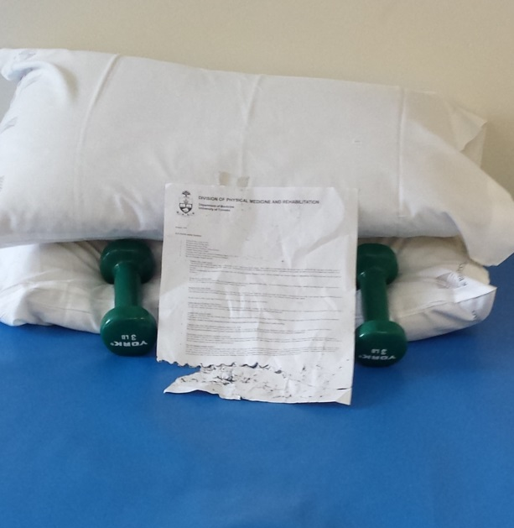
Lifting weights is not easy
Lack of natural arms was a challenge

Slide 11
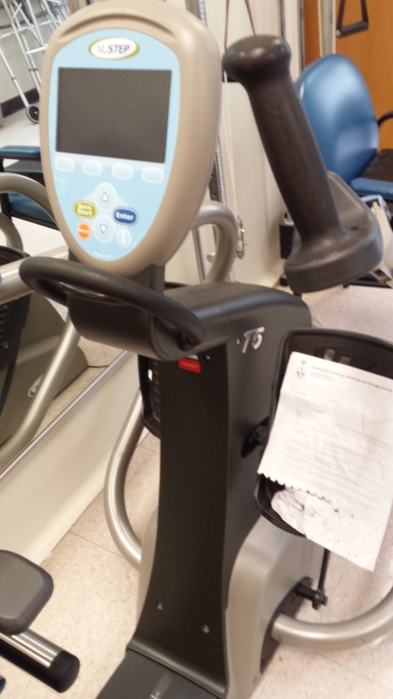
Cycling machine difficult with limited range of movement

Slide 12
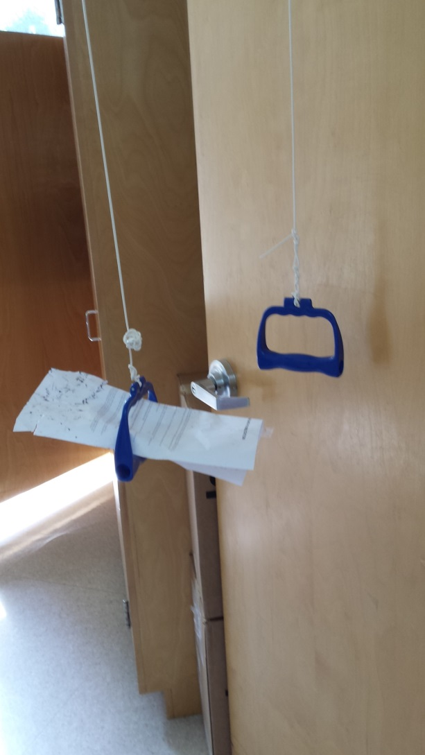
Need to work on upper extremity strength

Slide 13
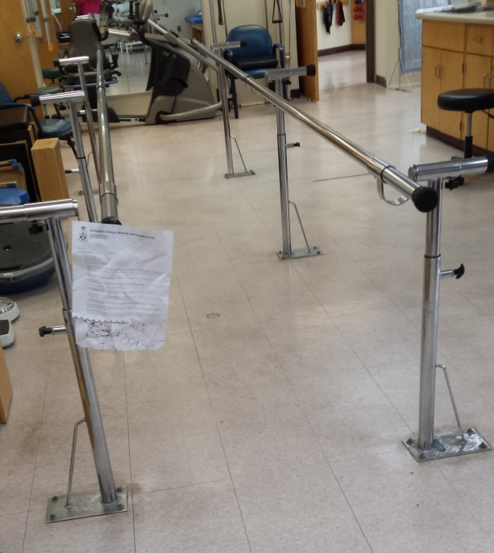
Taking baby steps

Slide 14
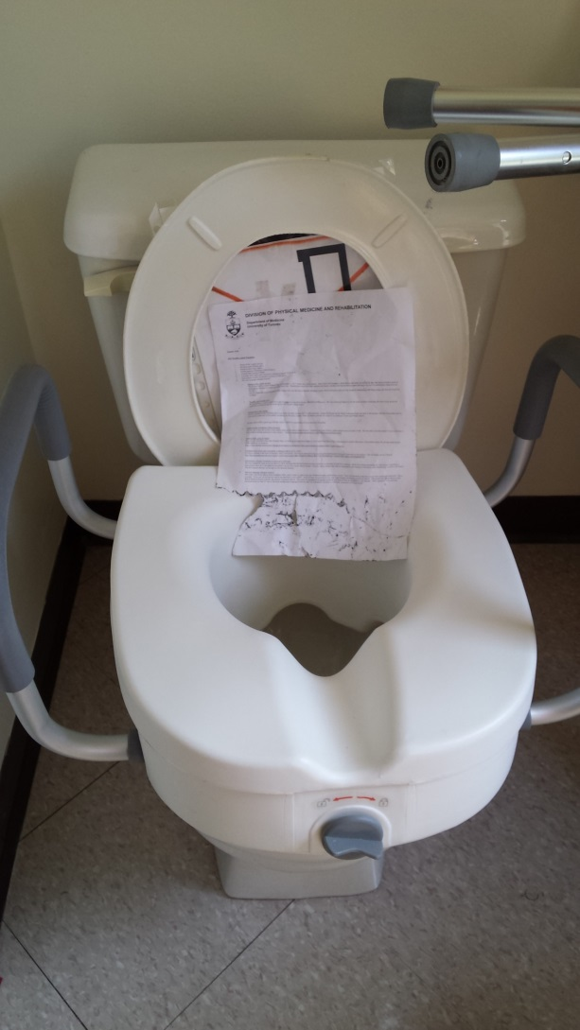
I hope everything comes out okay

Slide 15
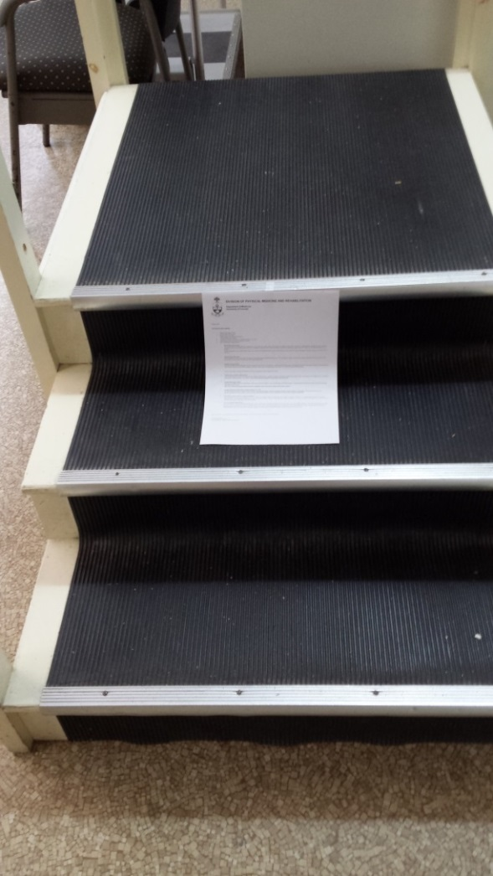
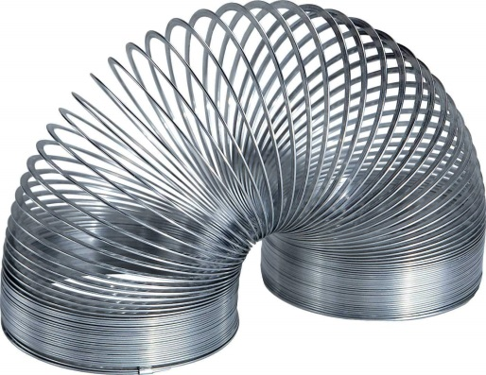
One step at a time
Someone asked what’s similar between the newsletter and a Slinky.
They’re both useless, but fun to push down the stairs.
The newsletter was sad.

Slide 16
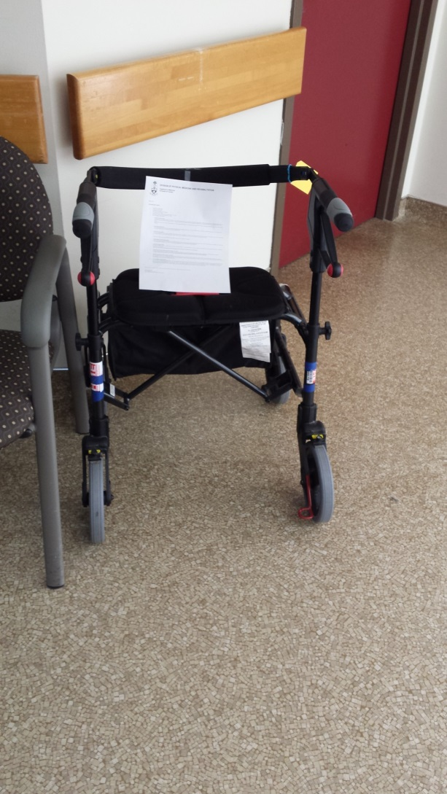
Have graduated to a walker!

Slide 17
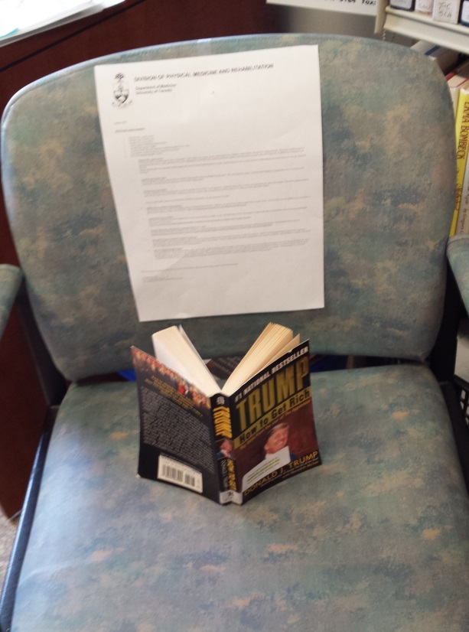
Got to catch up on some light reading
Was glad he lives in Canada and wasn’t an American newsletter.

Slide 18
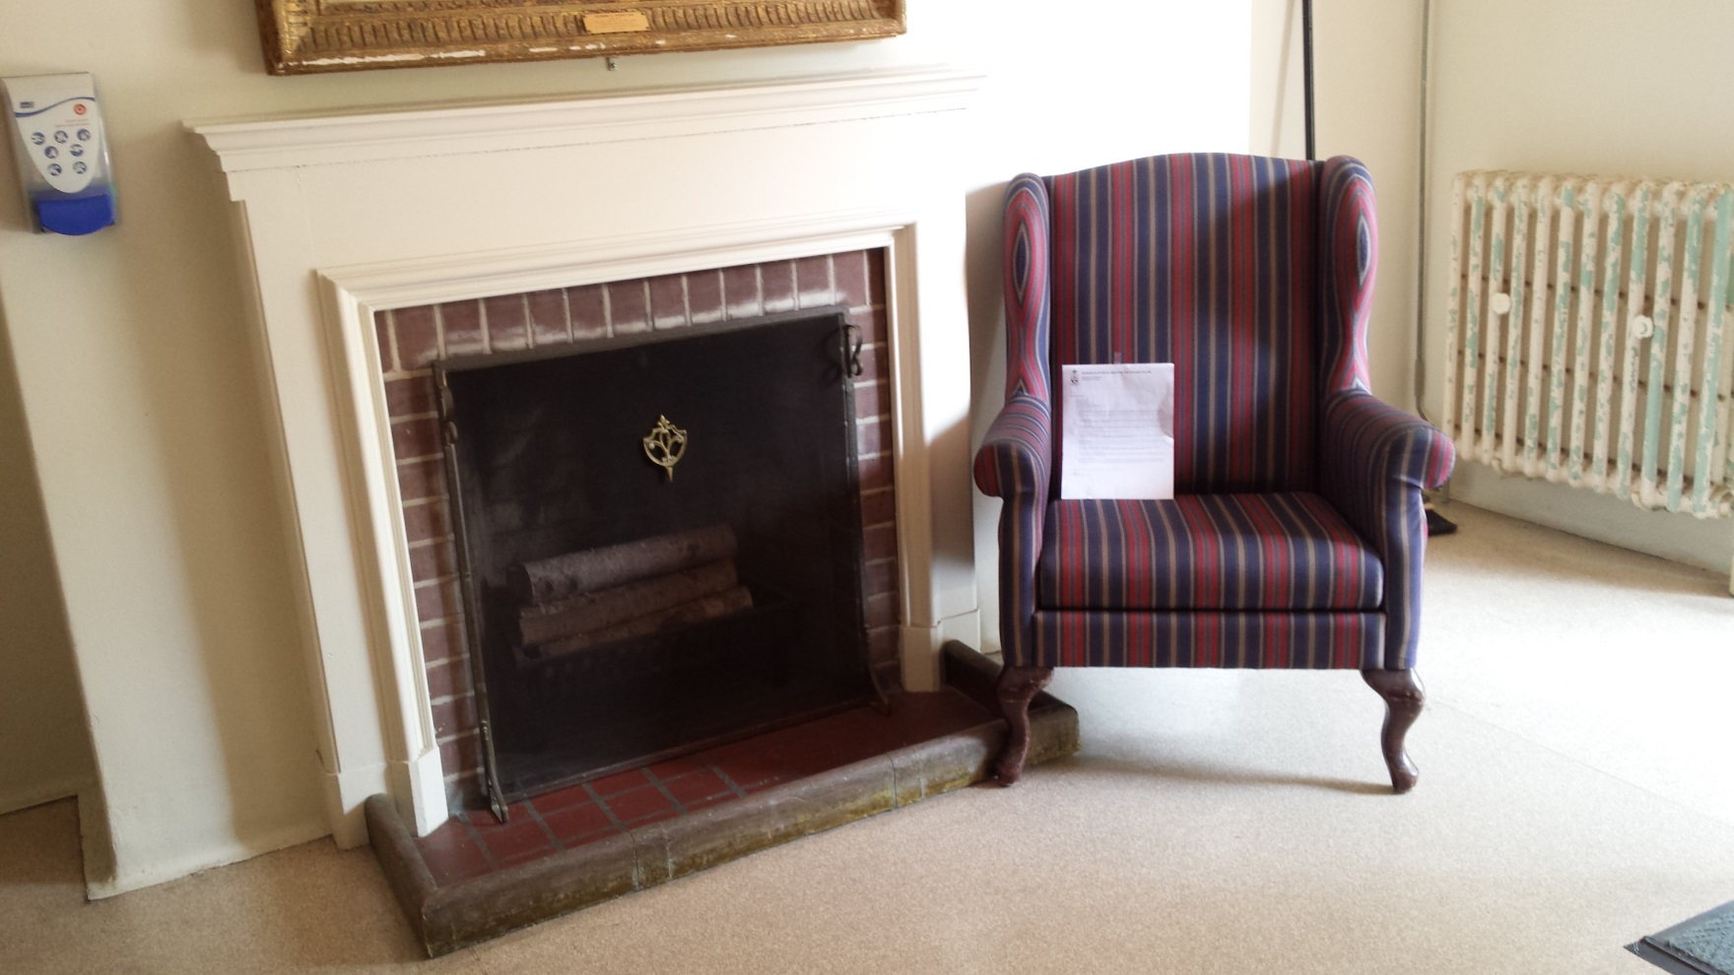
Had a fireside chat with the hand hygiene dispenser.

Slide 19
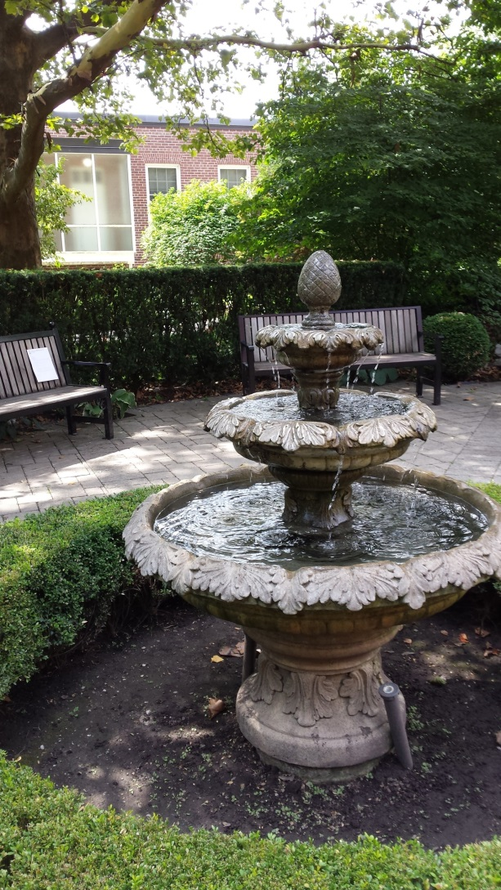
It’s been a long summer

Slide 20
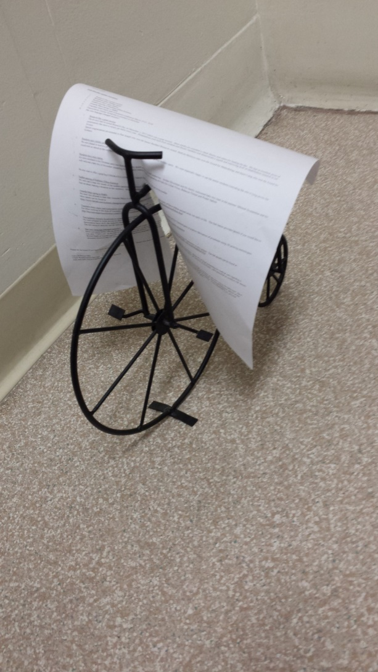
I have bought myself a new bike!

Slide 21
Hope you had a great summer!
I’ll be back in September.

